Slide 1
Graphics Final Project
by Ross Anderson

Slide 2
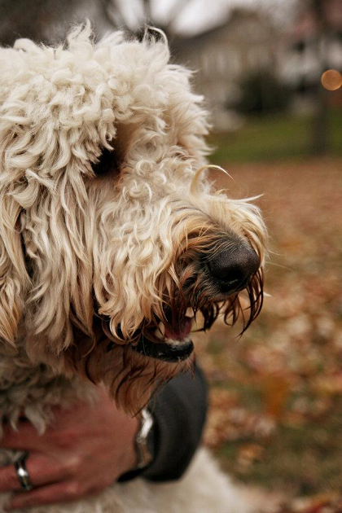



Can you tell the difference between these four images?
They are all .PNG Format, and each is sized at 420 x 630 pixels (slightly scaled down for presentation)
iTunes User Agreement + US Constitution Embedded (159KB of Text)
Original File
MLB Rules Embedded (283KB of Text)
Vikings Stadium Bill Embedded (333KB of Text)
Hint: File size is 488KB
Hint: File size is 459KB
Hint: File size is 451KB
Hint: File size is 485KB

Slide 3
Steganography
Hiding a message such that only the sender and intended recipient know a message exists
Prior to digital formats, invisible ink, microdots (a dot the size of a typewriter period, encoded with data), were among other creative means
Digital era could encode data in audio, images or video. (Other methods exist as well.)

Slide 4
How is it encoded?
Going back to the images earlier, the two with encoded data masked off the least significant bits, and encoded data from a text file.
2-3 bits red, 2-3 bits green, and 2-4 bits of blue were used (8bits for each color component is the storage format). Even at 2-2-2, there would be storage potential of 6 bits of data per pixel.
3-3-4 Seems to be the limit for the displayed picture with only minor changes. In the displayed images, the far right one was at 3-3-4, and was beginning to have blue specks show up in certain areas
Because the PNG format was used, the file sizes slightly shrank as the image and encoded data get compressed down.

Slide 5
Development
ILUT (From Assignment 5 was used to load the images into a C++ project) used to open image file
Data was extracted into a char array
Data to encode was masked into image data
Use ILUT to save image (could be converted to another format)
Filter (On next slide) was a simple loading of a texture (using ILUT), and applying a bitwise mask in the fragment shader to only show the LSB.
PNG Format was selected as it was lossless compression. JPG can be encoded as well, but by different means.

Slide 6
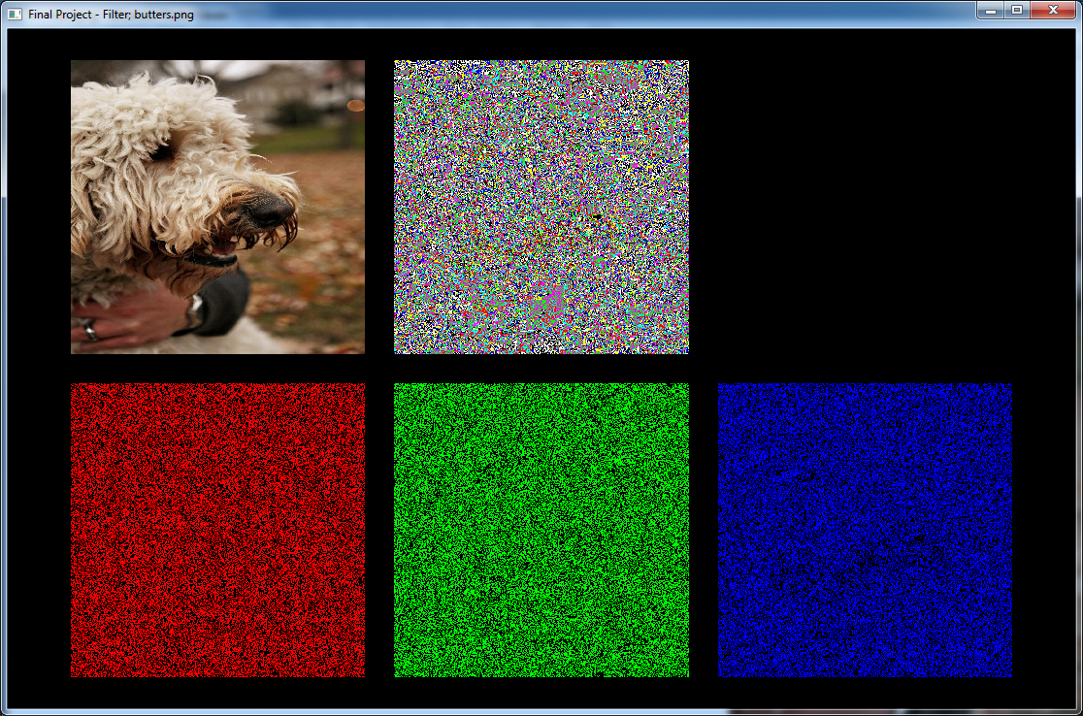
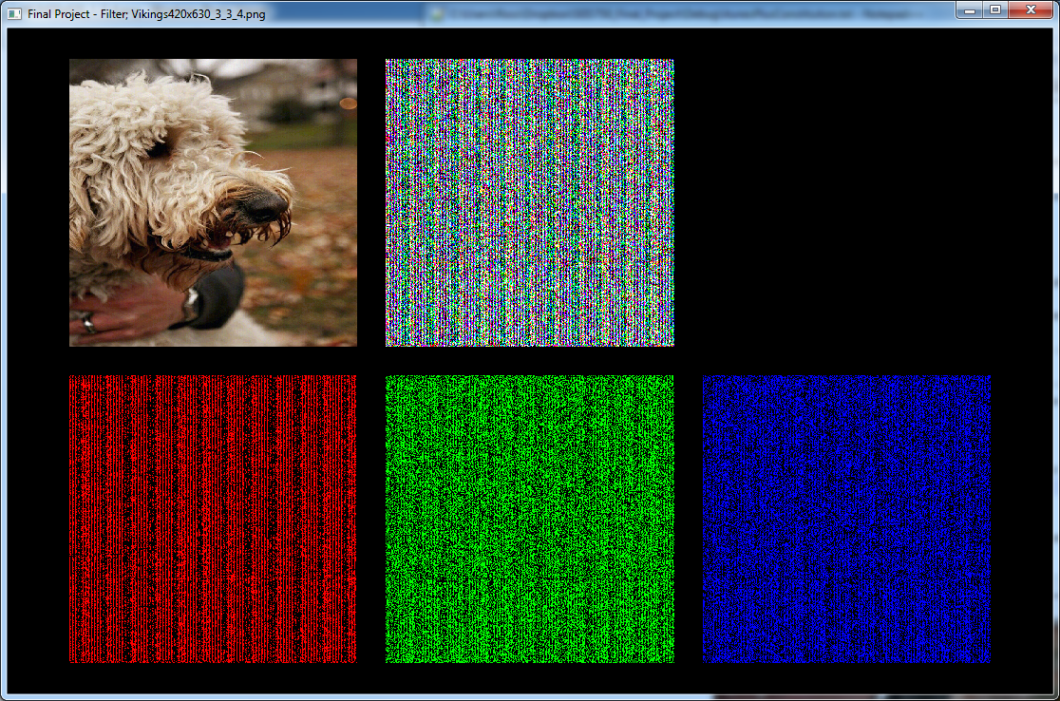
Detection
The way this was done was pretty crude and would be subject to detection (if looked for).
Below are images of the noise floor (Least significant bit of the original (left) and one of the altered images (right)
In the left picture, notice how in the blue, the outline of the eye and mouth can been seen. This level of detail is absent from the right image.

Slide 7
Avoidance
Had the text been encrypted prior to embedding, the noise floor would have been much more random and distributed
Certain images may be more accommodating for packing bits (i.e. A mostly green and blue picture could allow more bits of red, with less green and blue).

Slide 8
Uses
Such images could be published to sites such as eBay or Craigslist by the transmitter
Receiver would know to search specific site for a certain type of item at specific times
As long as sender and receiver weren’t under constant surveillance, this would likely be overlooked and go unnoticed

Slide 9
Recent Cases
June 2010 – 9 Russian Spies Arrested in US. Criminal complaint suspects Russian government developed software was used to encode encrypted messages into images.
May 2011 – Austrian with al-Qaeda links arrested in Germany. Memory cards found hidden in his underwear appeared to have pornographic videos. Videos were actually encoded with over 100 documents including possible attack plans and training manuals.

